Slide 1

Learning Analytics –
The Apereo Approach
ESUP Days & Apereo Europe 2016
Tuesday, February 2, 2016

Slide 2

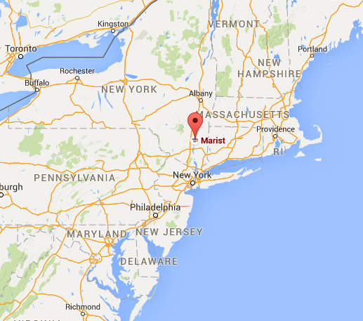


Learning Analytics in the United States:
Surveying the Landscape
Josh Baron
Assistant Vice President
Information Technology
for Digital Education
Notes:
Introduce myself…this session will primarily focused on a new ECAR/ELI Report on the emerging field of Predictive Learning Analytics so before I introduce my colleagues I would like to take a moment to recognize the larger Working Group who helped write the report…

Slide 3
Presentation Overview
Introduction – Why is Big Data and Analytics of Interest?
Historical Context – Open Academic Analytics Initiative (OAAI)
Overview of Apereo Learning Analytics Initiative
Current and Future Projects
Question and Answer

Slide 4
Why is Big Data and Analytics so Important in the United States?

Slide 5
39%
Reference: Integrated Postsecondary Education Data System (IPEDS) - https://nces.ed.gov/programs/digest/d14/tables/dt14_326.10.asp
Notes:
I think I can summarize the strategic importance of the emerging field of PLA with one number…
You can debate the specifics of how this number is derived but few would argue that it is a “good” number…
This number has implications well beyond higher education…

Slide 6
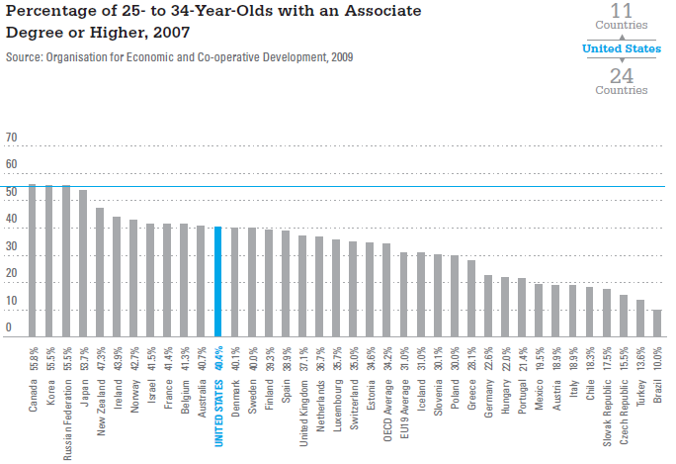
Notes:
Just as one example of the larger challenges that low graduation rates are having…
And, as we all know, the issue has caught the attention of mainstream media and major governmental groups….

Slide 7
How can Learning Analytics help?

Slide 8

“Marty, you are going to fail Introduction to Physics during your sophomore year, make sure you see a tutor after the first week of class and you’ll ace the final exam!”
Notes:
At a very fundamental level the ability to predict the future, at some reasonable level of accuracy, provides us with the opportunity to “intervene“ as means to change that future outcome

Slide 9
How is analytics being used in higher ed?
Academic Analytics | Learning Analytics
A process for providing higher education institutions with the data necessary to support operational and financial decision making* | The use of analytic techniques to help target instructional, curricular, and support resources to support the achievement of specific learning goals*
Focused on the business of the institution | Focused on the student and their learning behaviors
Management/executives are the primary audience | Learners and instructors are the primary audience
* - Analytics in Higher Education: Establishing a Common Language
Notes:
When you look at “analytics” initiatives within higher education from the 50,000 foot level there are two broad categories which seem to emerge: Academic Analytics and Learning Analytics…
UofM System: school revenues, degrees conferred, head counts, credit hours taught, etc.
Ask how many people are familiar with Course Signals

Slide 10
Past, Present and Future Uses of Analytics
Predictive Analytics - Future
Use large amount of historical data to create predictive models
Automated Analytics - Present
Automatically perform analytics and provide results directly to end-users
Reporting Analytics - Past
Report on past trends and data observations

Slide 11
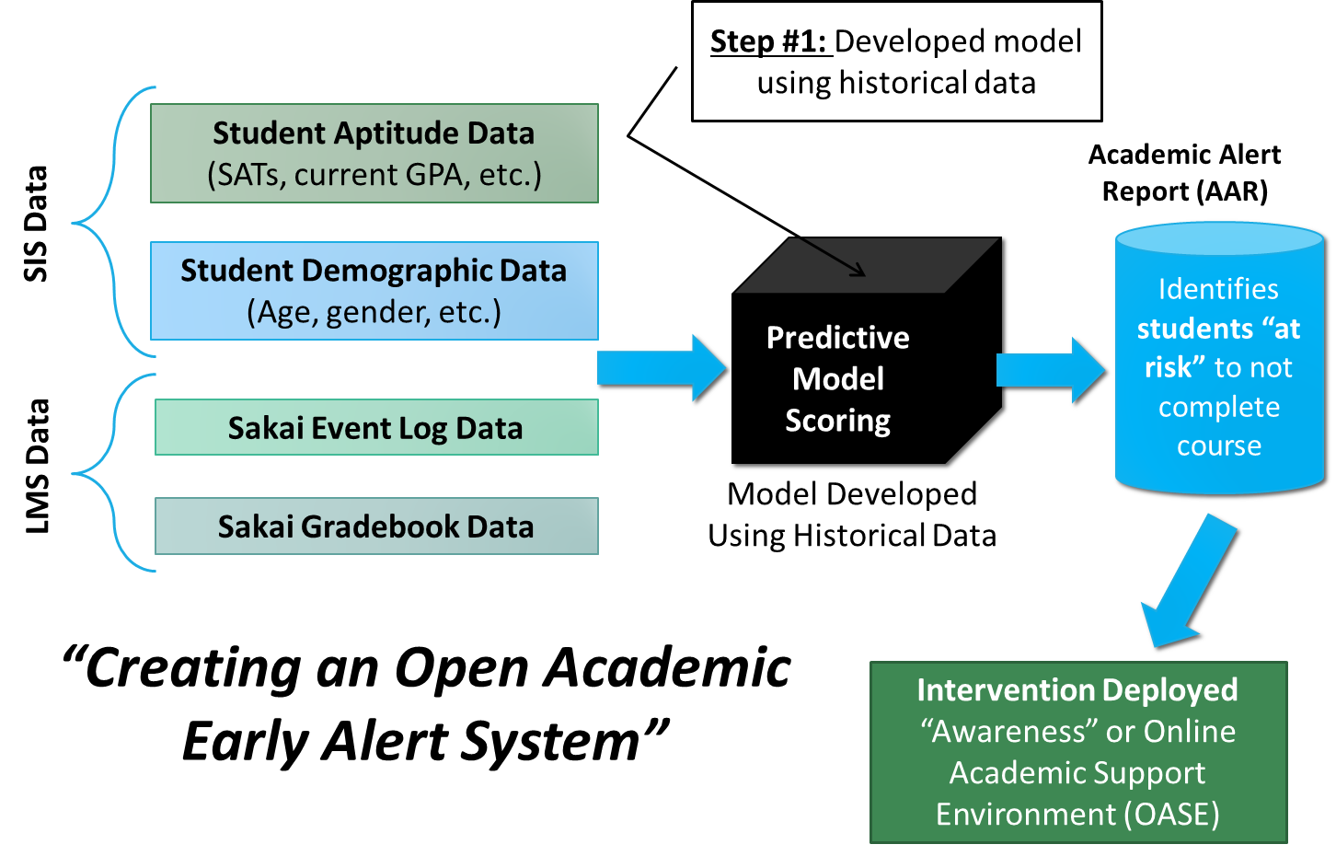
Open Academic
Learning Analytics
Initiative (OAAI)
Some brief historical context…

Slide 12


Open Academic Analytics Initiative
EDUCAUSE Next Generation Learning
Challenges (NGLC)
Funded by Bill and Melinda Gates Foundations
$250,000 over a 15 month period
Goal: Leverage Big Data concepts to create an open-source academic early alert system and research “scaling factors”
Notes:
OK, so what is the OAAI and how are we working to address this problem…with the goal of leveraging Big Data to create an open-source academic early alert system that allows us to predict which students are at risk to not complete the course (and do so early on in the semester) and then deploy an intervention to help that student succeed.

Slide 13
OAAI Early Alert System Overview
Notes:
I’ll talk about our intervention strategies in a little more detail a bit later on in the presentation…

Slide 14
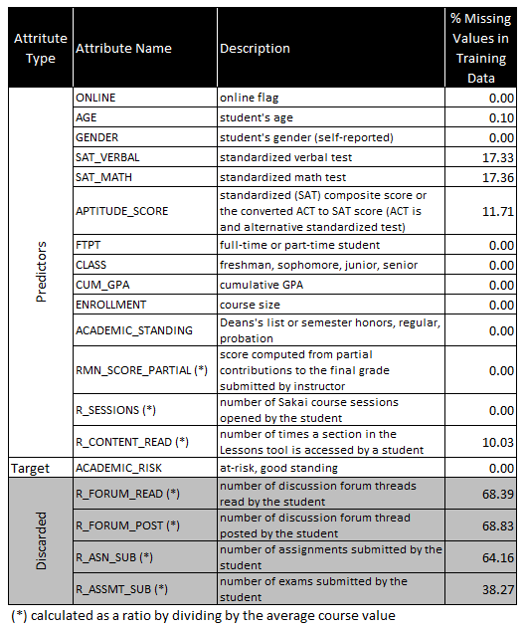
Predictors of
Student Risk
LMS predictors were measured relative to course averages.
Some predictors were discarded if not enough data was available.

Slide 15
Research Design
Deployed OAAI system to 2200 students across four institutions
  Two Community Colleges
  Two Historically Black Colleges and Universities
Design > One instructor teaching 3 sections
  One section was control, other 2 were treatment groups
Each instructor received an AAR three times during the semester
  Intervals were 25%, 50% and 75% into the semester

Slide 16
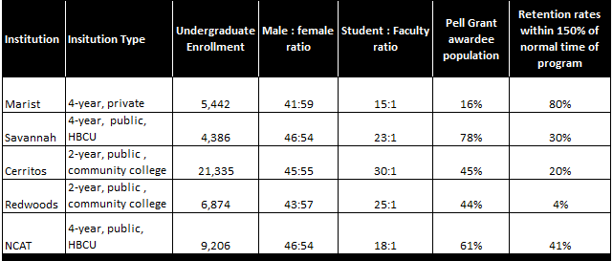
Institutional Profiles

Slide 17
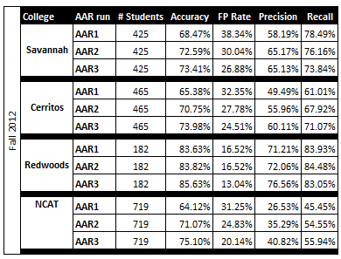
Predictive Model Research Findings
Conclusion
Predictive model frameworks are more “portable” than anticipated.
Predictive model frameworks can provide a “jump start” for developing models.
It is possible to create a library of open predictive models frameworks that could be shared globally.

Slide 18
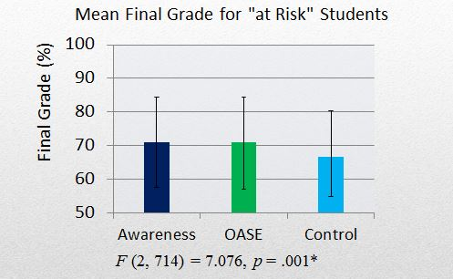
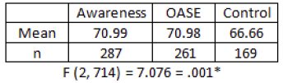
Intervention Research Findings -
Final Course Grades
Analysis showed a statistically significant positive impact on final course grades
  No difference between treatment groups
Saw larger impact in spring than fall
Similar trend among low income students

Slide 19
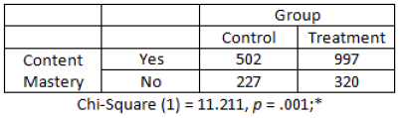
Intervention Research Findings -
Content Mastery
Student in intervention groups were statistically more likely to “master the content” than those in controls.
  Content Mastery = Grade of C or better
Similar for low income students.

Slide 20
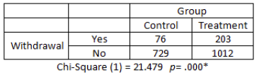
Intervention Research Findings -
Withdrawals
Students in intervention groups withdrew more frequently than controls
Possibly due to students avoiding withdrawal penalties.
Consistent with findings from Purdue University

Slide 21
More Research Findings…
Jayaprakash, S. M., Moody, E. W., Lauría, E. J., Regan, J. R., & Baron, J. D. (2014). Early Alert of Academically At-Risk Students: An Open Source Analytics Initiative. Journal of Learning Analytics, 1(1), 6-47.

Slide 22

Strategic Lessons Learned
Open Academic analytics initiative (OAAI)

Slide 23
Lesson Learned #1
Openness will play a critical role in the future of Learning Analytics

Slide 24

Intersections between openness and Learning Analytics
Open Source Learning Analytics Software
  Weka, Kettle, Pentaho, R, Python etc.
Open Standards and APIs for Learning Analytics
  Experience API (xAPI), IMS Caliper/Sensor API
Open Models - Predictive models, knowledge maps, PMML etc.
Open Content/Access – Journals, whitepapers, policies documents
Openness or Transparency with regards to Ethics/Privacy
NOT anti-commercial – Commercial ecosystems help sustain OSS

Slide 25
Lesson Learned #2
Software Silos Limit Learning Analytics

Slide 26

Software Silos vs. Platforms
Many learning analytics solutions today are
“tool” or “software-centric”
  Analytics tools are built into existing software such as the
  Learning Management System (LMS)
Can make it harder to capture data and
integrate across systems (limits Big Data)
A platform solution would allow institutions
to collect data from across many systems
  A “modularized platform” approach allows institutions to use all or just some components
  Integration points allow data to “flow” in for processing and results to flow out

Slide 27
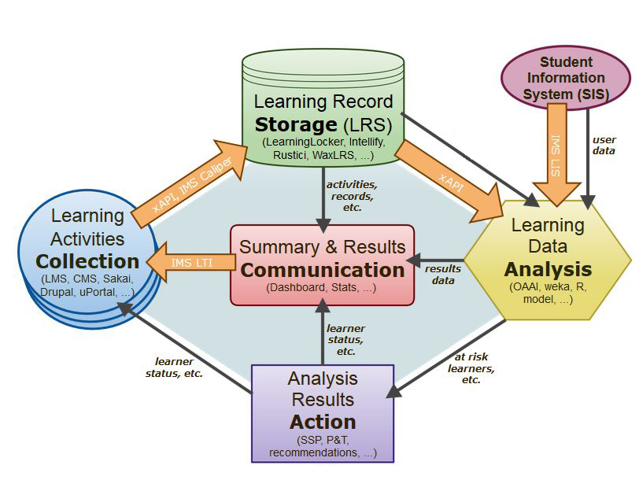
Apereo Learning
Analytics Initiative (LAI)
Overview and updates

Slide 28
Modular Components of an
Open Learning Analytics Platform
Collection – Standards-based data capture from any potential source using Experience API and/or IMS Caliper/Senor API
Storage – Single repository for all learning-related data using Learning Record Store (LRS) standard.
Analysis – Flexible Learning Analytics Processor (LAP) that can handle data mining, data processing (ETL), predictive model scoring and reporting.
Communication – Dashboard technology for displaying LAP output.
Action – LAP output can be fed into other systems to trigger alerts, etc.
Library of Open Models

Slide 29

Apereo Learning Analytics Initiative (LAI)
Goal: Operationalize outcomes from Learning Analytics research as
means to develop, maintain and sustain modular components that
integrate to support an open modular platform for Learning Analytics
Current Apereo LAI Related Projects
  Marist College – Learning Analytics Processor (LAP)
  Unicon – OpenLRS (Learning Record Store) and Student Success Plan (SSP)
  University of Amsterdam – Larrisa (open-source Learning Record Store)
  Uniformed Services University – OpenDashboard
Join the mailing list: analytics@apereo.org
(subscribe by sending a message to analytics+subscribe@apereo.org)
Wiki Page: https://confluence.sakaiproject.org/x/rIB_BQ
GitHub: https://github.com/Apereo-Learning-Analytics-Initiative
Apereo Incubation Project
Apereo Endorsed Project

Slide 30
Modular Components of an
Open Learning Analytics Platform
Collection – Standards-based data capture from any potential source using Experience API and/or IMS Caliper/Senor API
Storage – Single repository for all learning-related data using Learning Record Store (LRS) standard.
Analysis – Flexible Learning Analytics Processor (LAP) that can handle data mining, data processing (ETL), predictive model scoring and reporting.
Communication – Dashboard technology for displaying LAP output.
Action – LAP output can be fed into other systems to trigger alerts, etc.
OpenLRS & Larrisa
Learning Analytics Processor (LAP)
OpenDashboard
Student Success Plan
Library of Open Models

Slide 31
Learning Analytics Processor (LAP)
.
.
.
#2 – ETL Processing
.
#1 – Data Extract
OAAI XML
#4 - Output
LMS
Admin tool
activities.csv
Learning Analytics Processor (LAP)
RESTful API
grades.csv
Student ID, Course ID, Risk Rating
#3 – Model Scoring
Demographics from SIS

Slide 32
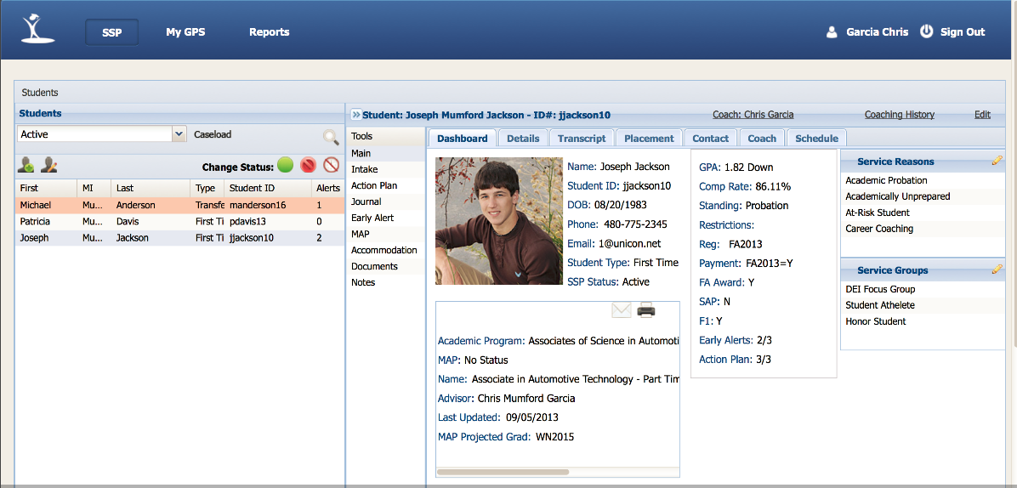
Student Success Plan (SSP)

Slide 33
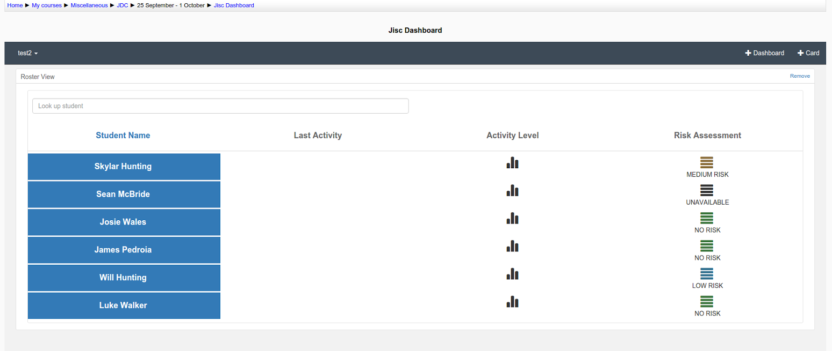
OpenDashboard

Slide 34
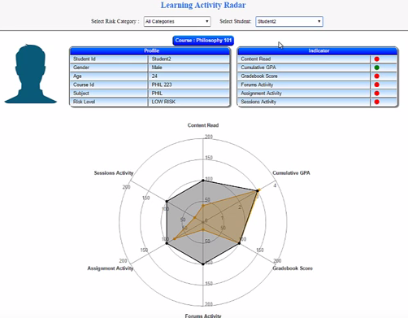
Learning Activity Radar
Video demonstration - https://youtu.be/m-4NbxXllpY

Slide 35
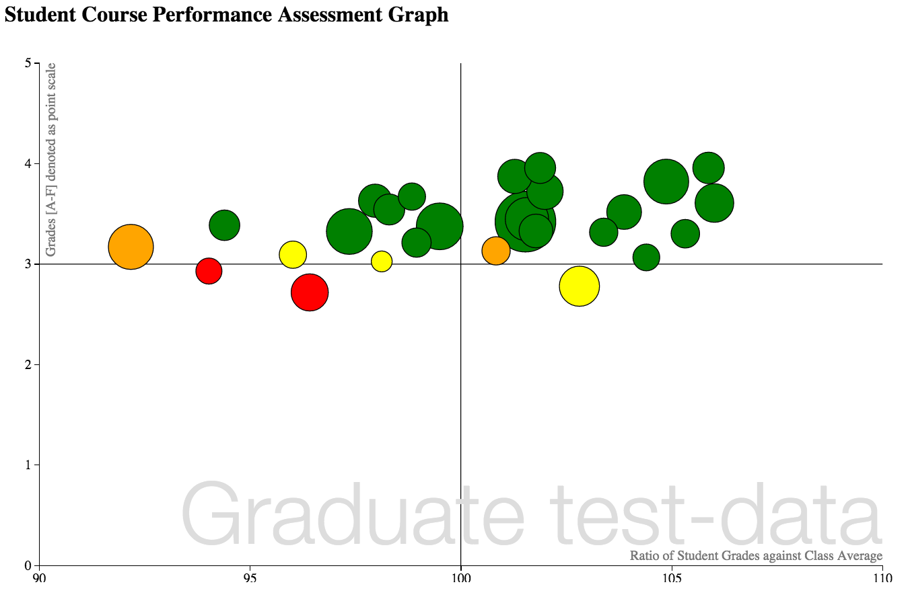
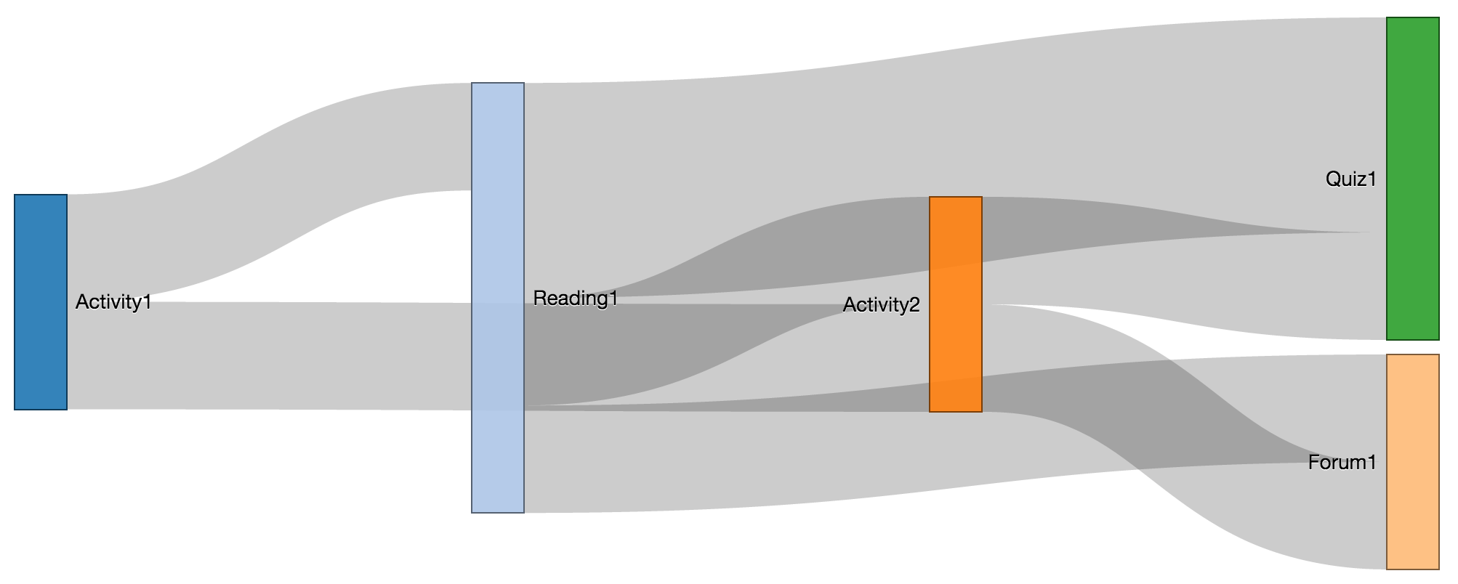
LAK15 Hackathon - Open Dashboards
Course Engagement Pathways – Resource & Content Access
Early Alert Insights Chart

Slide 36



Current & Future Projects
Apereo learning analytics initiative

Slide 37


North Carolina State University
Began exploring Learning Analytics about two years ago
Decided to conduct initial Data Model Analysis as a “Phase One” project
  Ran small sample (500+ records) of historical data through the Marist predictive model
Phase One Data Model Analysis Results…
  Model accuracy: 75 – 77%
  Recall rates: 88 – 90%
  False positives: 25 – 26%
Created necessary Extraction, Transformation and Loading (ETL) processes for Moodle
Allowed them to address policy and data access issues without a high-stakes deployment
NC State is now starting a Phase Two project to prepare for large scale deployment
Recent Webinar: https://youtu.be/ODPTjNcqNuo

Slide 38
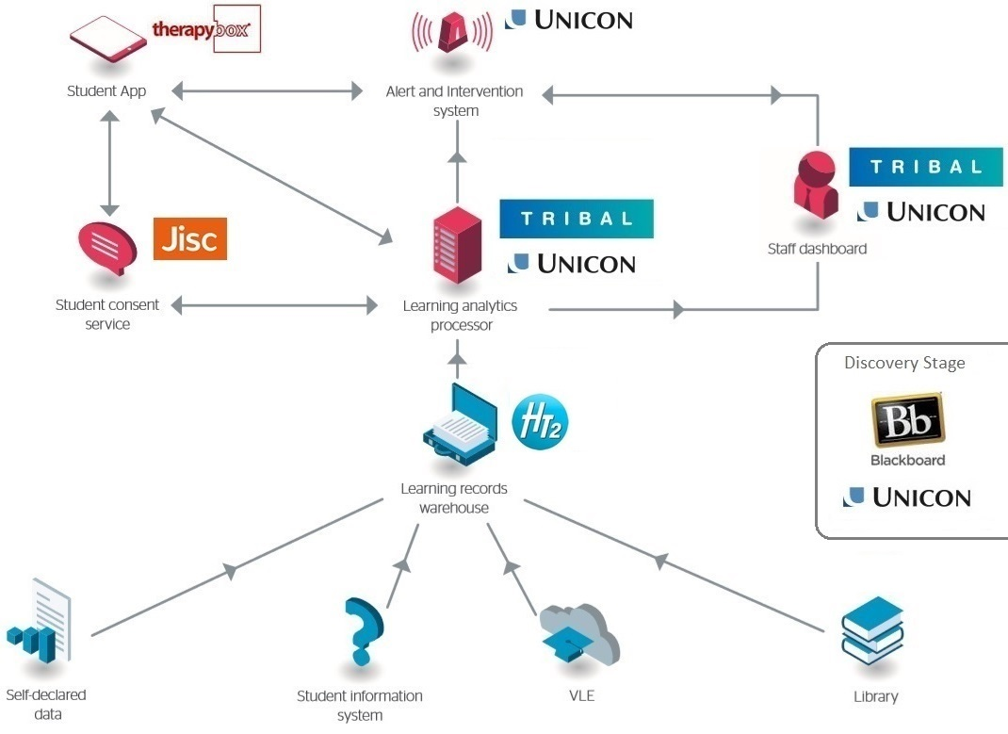

Student Success Plan
Jisc National Learning Analytics Project
Government funded non-profit that provides technology services to all of UK higher education
Adopted much of the Apereo LAI platform and openness strategy
Funding two-year project to create a highly scalable cloud-based learning analytics service
All work released under open licenses
Initial code release in late Spring 2016
OpenDashboard
Learning Analytics Processor (LAP)
Project Blog: http://analytics.jiscinvolve.org/wp

Slide 39

Apereo – Jisc Sponsored
Learning Analytics Hackathon
Two organizations leading the way worldwide in developing open architectures for learning analytics are coming together at LAK16 in Edinburgh for a two-day hackathon on April 25-26, 2016. Jisc and Apereo will put the growing ecosystem of learning analytics products through their paces with experimental big data coming from learning management systems, student record systems and other sources.
http://lak16.solaresearch.org/

Slide 40

Looking to learn more?
Join the mailing list!
analytics@apereo.org
(subscribe by sending a message to analytics+subscribe@apereo.org)
Apereo Learning Analytics Initiative
Wiki: https://confluence.sakaiproject.org/x/rIB_BQ
GitHub: https://github.com/Apereo-Learning-Analytics-Initiative
Josh Baron: Josh.Baron@marist.edu

Slide 41
Slide Archive
Will Use Only if Needed

Slide 42
Strategic Considerations
Learning Analytics: Fueling Actionable Intelligence

Slide 43
Strategic Considerations
#1
Organizational Leadership, Culture & Skills
#2
Gaining Access to Learning Data
#3
Ethics &
Privacy

Slide 44
Organizational Leadership, Culture & Skills
Having a senior organizational champion can be critical
  Breaking down data silos and support policy change
  Addressing resource requirements
  Develop a data-driven decision making culture
Having division, faculty and student champions is also important
  Coordination on data extraction, transformation and loading (ETL)
  Assist with communication across entire community
Investing in new skill sets is an imperative – see report for specifics

Slide 45
Graining Access to Learning Data
Learning Data: Data produced by learners as they engage in the learning process.
  Examples: course grades, GPA, library data, LMS event log data, test scores
Learning data is the “fuel” on which LA runs
Access can be an implementation barrier
  Data may have not been intended for LA use originally
  Challenges extracting data from cloud-based SaaS
  Data in local systems can be “hidden” or encrypted
Extracting sample data sets is often a good start

Slide 46
Ethics and Privacy
Ethics: Using LA for “good” and not “evil”
Privacy: Balancing the need to protect confidential records while maximizing the benefits of LA.
Often requires new policies and procedures
Learning Analytics “task force” to address ethics and privacy issues
Jisc Code of Practice - https://www.jisc.ac.uk/guides/code-of-practice-for-learning-analytics
SURF Learning Analytics SIG - https://www.surfspace.nl/sig/18-learning-analytics/93-ethics/

